Slide 1
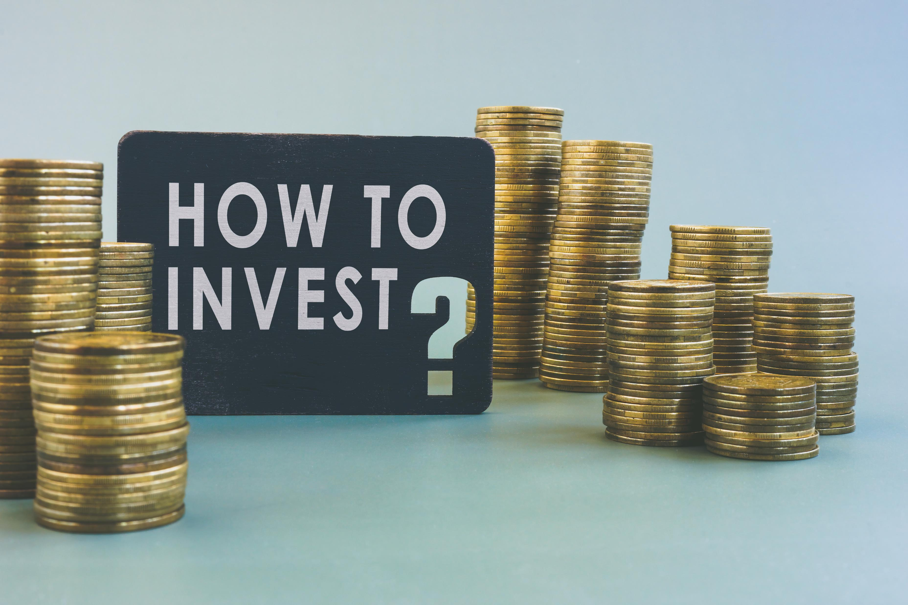
Unit 5: Investing Your Money

Slide 2
Preview the Topic
What do you know about investing your money?

Slide 3

Think, Pair, Share
What are the payoffs for investing your money?

Slide 4

Payoffs
Taking control of your money
Being independent
Having financial security
Building wealth over a lifetime
Having a comfortable retirement

Slide 5
While in school:
Get in the habit of saving money, even if it is a small amount
Save for an emergency fund
Avoid too much debt

Slide 6

Understanding Interest
Interest
  The amount of money you pay to borrow money, or the money paid to you from a savings account or investment.
Simple Interest
  Calculated on the principal only. The principal is the amount of money loaned or invested.
  Example: If you deposit $100 in a savings account at 2% interest yearly, you will have $102 at the end of the year.
  ($100 X .02 X 1 = $102)

Slide 7
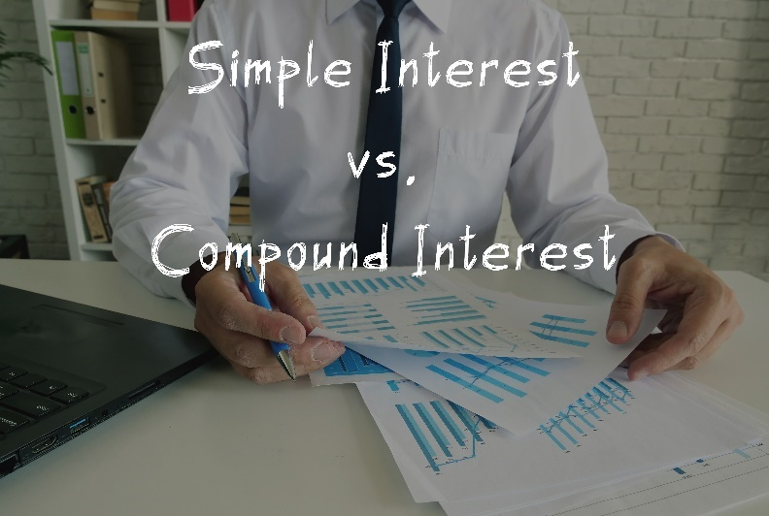

Slide 8
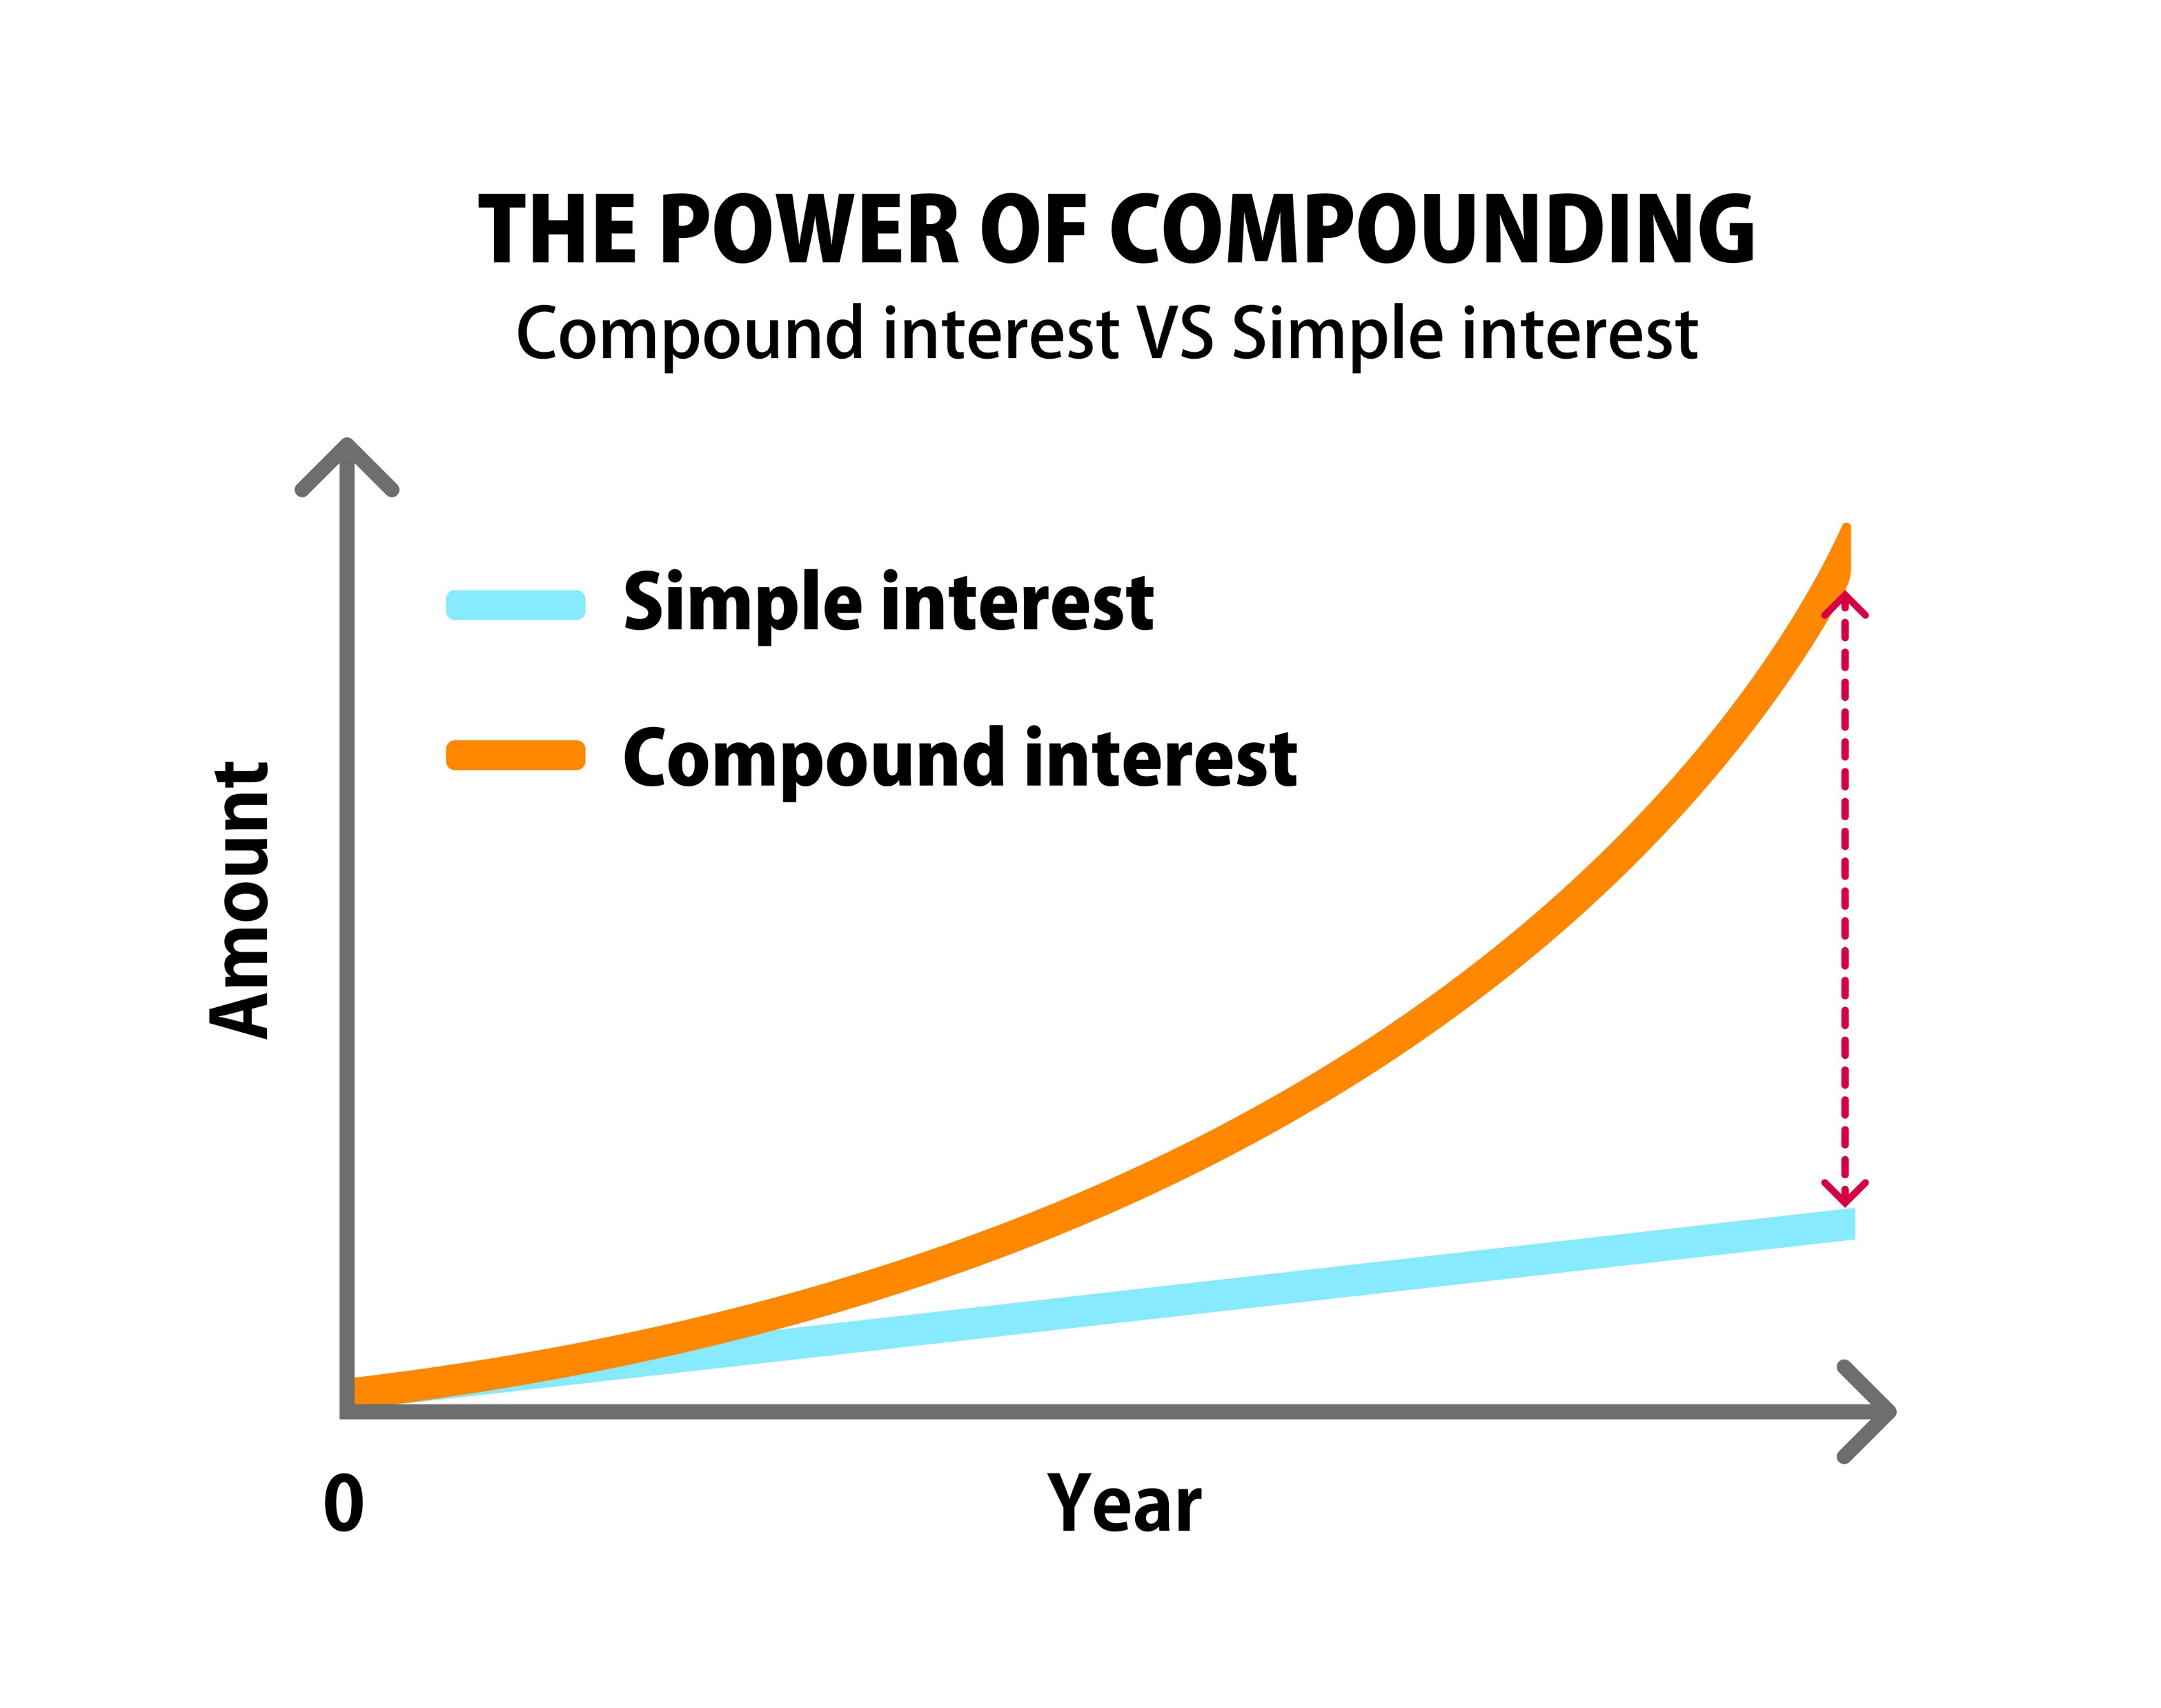
Compound Interest
Calculated on the principal amount plus the accumulated interest. It is “interest on interest.”

Slide 9
Compound Interest Example
If you invest $100 at 7% compound interest, here is how your money grows over time:
Year 1 | $100 X .07 = | $107.00
Year 2 | $107 X .07 = | $114.49
Year 3 | $114.49 X .07 = | $122.50
Year 4 | $122.50 X .07 = | $131.08
Year 5 | $131.08 X .07 = | $140.25
Year 6 | $140.25 X .07 = | $150.06
Year 7 | $150.06 X .07 = | $160.57
Year 8 | $160.57 X .07 = | $171.81
Year 9 | $171.81 X .07 = | $183.80
Year 10 | $183.84 X .07 = | $196.67

Slide 10

How to Double Your Money
An asset earning 7% compound interest will double in approximately 10 years. The process of accumulating interest over time is called the time value of money.

Slide 11

Simple Vs. Compound Interest
Simple interest is good if you are paying for a loan.
Compound interest is better if you are investing your money.

Slide 12
Start Investing Early
If you invest $200 a month at 7% interest starting at age 22, you will have $104,732 at age 65.
If you invest $200 a month at 7% interest starting at age 50, you will have only $36,177 at age 65.

Slide 13

Learn about Investment Options

Slide 14
Stocks
Purchasing stocks is buying a small piece of a company. For example, you can purchase stocks in Apple or Amazon and share in the profits and losses of these companies.

Slide 15

The Stock Market
The marketplace for stocks
Often influenced by consumer confidence and emotions

Slide 16
Bonds
When your purchase bonds, you are loaning the government or company money at a fixed rate over a predictable period of time. Bonds are considered a less risky investment but often have lower returns on your investment.

Slide 17
Risk Vs. Reward
The higher the risk, the higher the potential reward.
The lower the risk, the lower the potential reward.

Slide 18
Stand up if you agree:
I prefer higher risk and higher rewards.
Or
I prefer lower risk and predictable but lower rewards.
It all depends on your tolerance for risk.

Slide 19
Index or Mutual Funds
These are a collection of investments that are professionally managed. You pay a small percentage of your profits for management.
When you have a variety of investments, this is called a diversified portfolio.
Diversified portfolios are less risky since you have a variety of investments. “Don’t put all your eggs in one basket!”

Slide 20

The Standard and Poor’s 500 Index Fund
The top 500 companies on the stock exchange.

Slide 21
401K Plans
Employers offer these plans for retirement savings and investments. Money grows tax free until you take it out.
Employers sometimes match your contributions. For example, for every dollar you invest, the company adds a dollar. Be sure to take advantage of a 401K by investing as much as possible.

Slide 22
Roth IRA
This is another common type of retirement investment you can open on your own. Investments grow tax free.

Slide 23
Real Estate
Buying a home can be one of your best investments.
Average yearly returns are 11.1% and trending higher.

Slide 24

How to Start Investing for Beginners

Slide 25
Group Discussion
What are your recommendations for someone just beginning to think about investing their money?

Slide 26

Guidelines for Investing
Be informed about investment options.
Diversify your investments to minimize risk.
Invest a small amount of money consistently and increase the amount as your income increase.
Begin investing early in life to take advantage of compound interest and the time value of money.
Invest over the long run. Avoid taking money out of your investments.

Slide 27
Challenge: How to Become a Millionaire
Compound Interest Calculator from Investor.gov
How much would you have to invest each month at your present age to become a millionaire at age 65? Assume a 7% interest rate and a zero-interest variance.

Slide 28

Intention Statements
What are your intentions for investing your money in the future? Can you come up with at least 5 ideas in 5 minutes?
I intend to:
After 5 minutes, share one of your best ideas.

